Slide 1

We Engineer your Digital Success
Proposal for Development of an Loyalty Point Management Application
Sept 2016
© 2016. All Rights Reserved / www.verbat.com

Slide 2

Contents
1
Background & Scope
2
Solution Overview
3
Application Functionality
4
Discovery Phase
5
Application Delivery
6
Technology Specification
7
Project Timeline
8
Deliverables
9
Commercials
10
Assumptions & Out of scope
11
Terms & Conditions

Slide 3
Background & Scope
RAVIZ Hotels and Resorts plans to introduce a loyalty and rewards program card for their high value customers. This card can be tracked using a companion mobile app. The app can be used in lieu of the rewards card.
Scope
RAVIZ hotels and resorts has contacted Verbat Technologies to develop a Web & Mobile based loyalty management application, that will cater to the needs of its retail client. The main objective of the application, is to handle the entire process of managing the retail client’s loyalty program, by utilizing the web, android and iOS platforms. The main scope of the application is to allow customers to earn & redeem rewards. It also consist of a back office application to manage the rewards program.

Slide 4
Issues
Customer has to carry the card in person
Verification is manual
Cannot track card use
Cannot track rewards
Cannot track customer profile
Does not allow new promotions
Cannot cross sell

Slide 5
Scope
ICLP has contacted Verbat to develop an Loyalty Point Management application with the following features:
Customer Features
Register to view Instant offers
Out App Notification
Geo located offers
Badges & In-App Notifications
Scan receipts from print ads
View/Redeem rewards
View reward utilization history
Ask questions/send complaint
Cardholder details
Account Balance
Link to web site
Card Display
System Features
Create card
Track purchases
Track reward points
Point value assignment
Determine customer profile
Track coupon
Track bonus points
Geo-fencing
Redemptions
Admin Features
Create card suites (price, discount rates, amenities, period etc.)
Create virtual coupons
Create Properties (name, location, map coordinates etc.)
Real time statistics (hotel manager)
Customer profiles
Key management (assign rooms)
Hotel Staff
Scan / Read card barcodes
Override defaults
Issue card
Duplicate card
Redeem points & apply discounts
Scan vouchers and apply to card
Apply reimbursements

Slide 6
Application features
Customer features
Track purchases
Track reward points
Point value assignment
Determine customer profile
Track coupon
Track bonus points
Geo-fencing
Redemptions

Slide 7
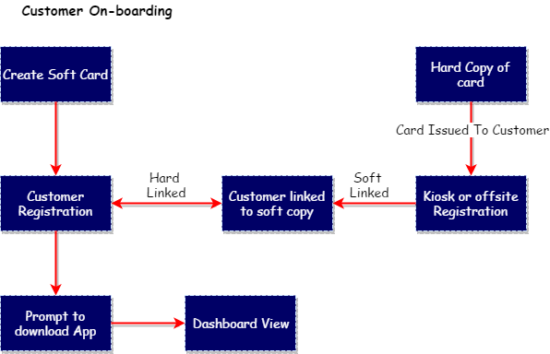
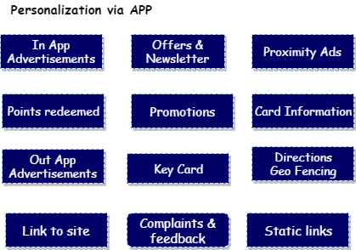
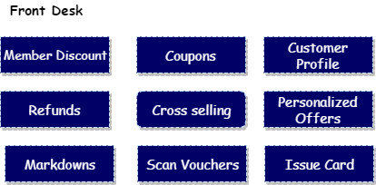
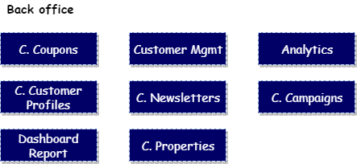

Slide 8
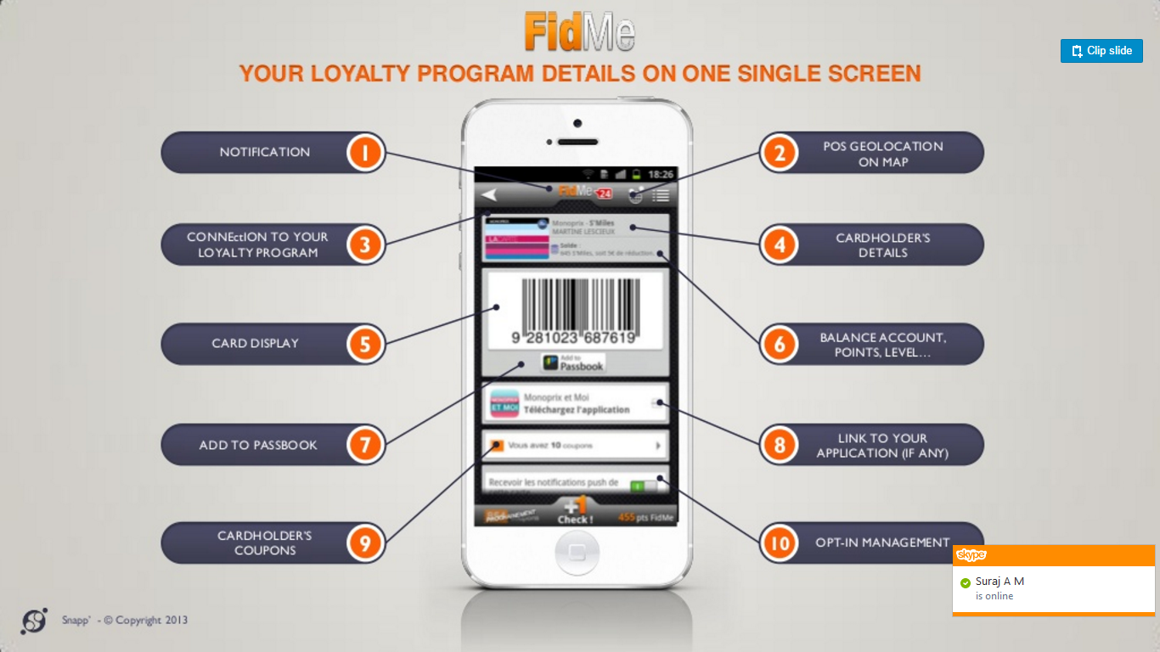

Slide 9
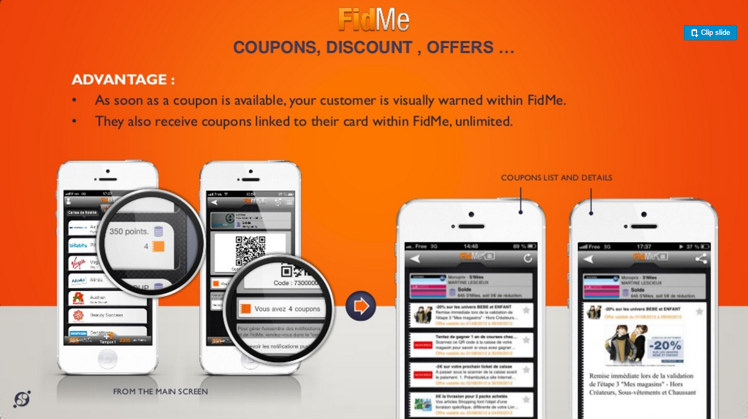

Slide 10
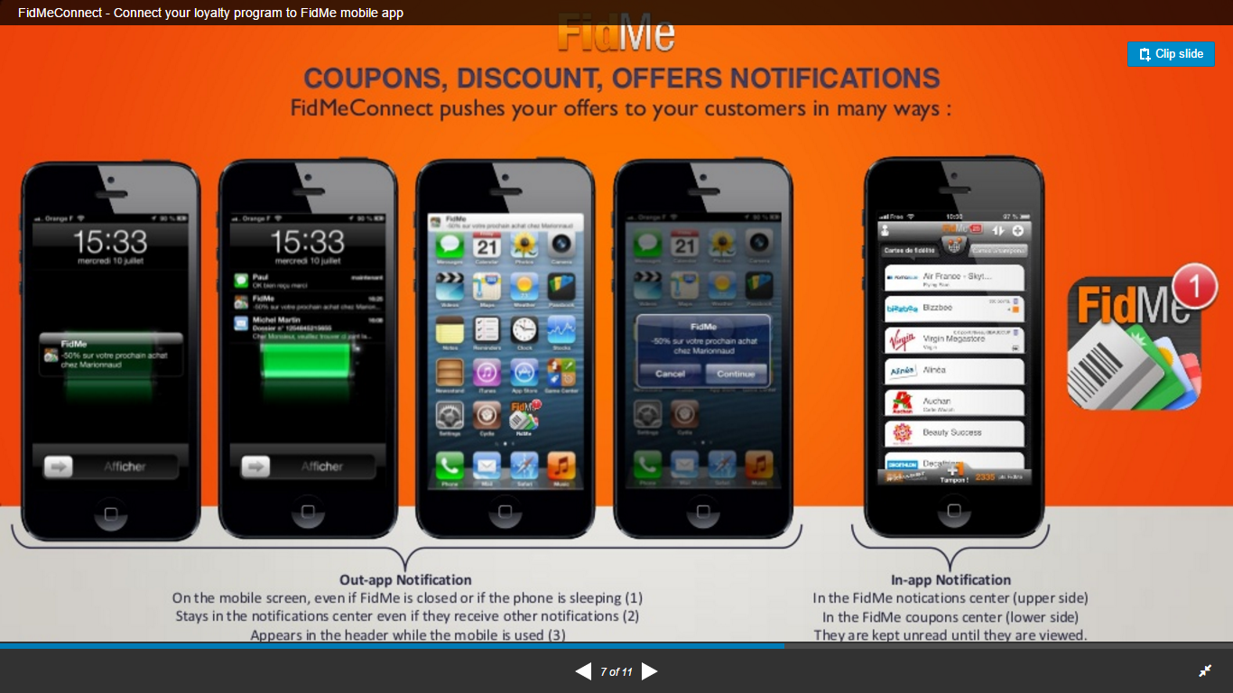

Slide 11
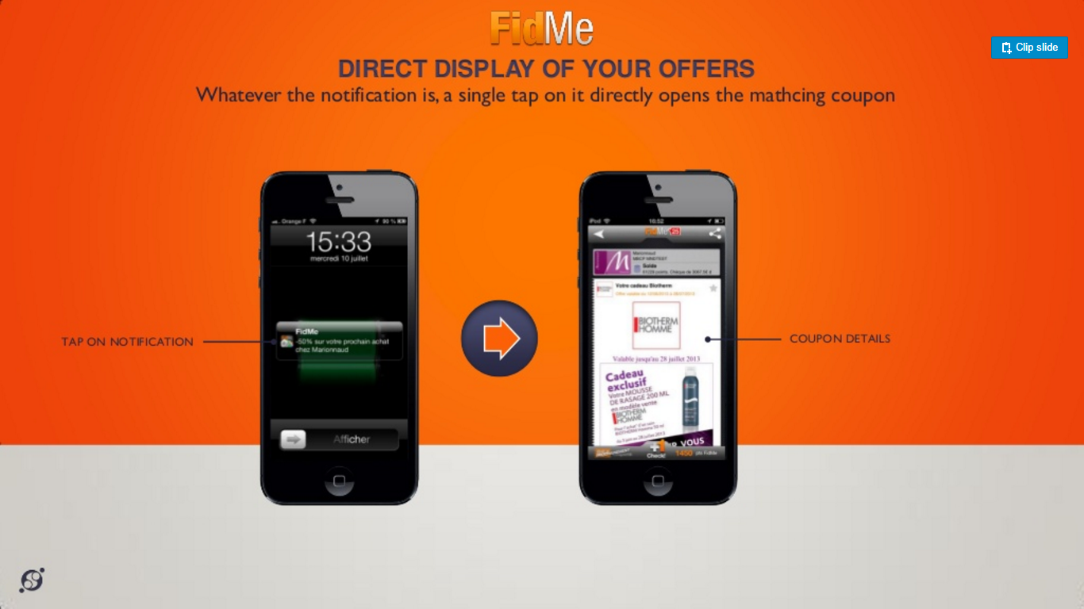

Slide 12
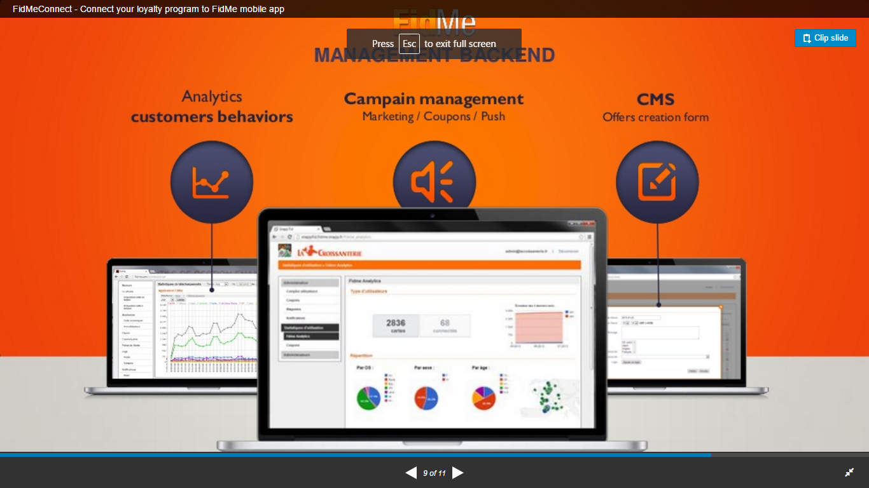

Slide 13
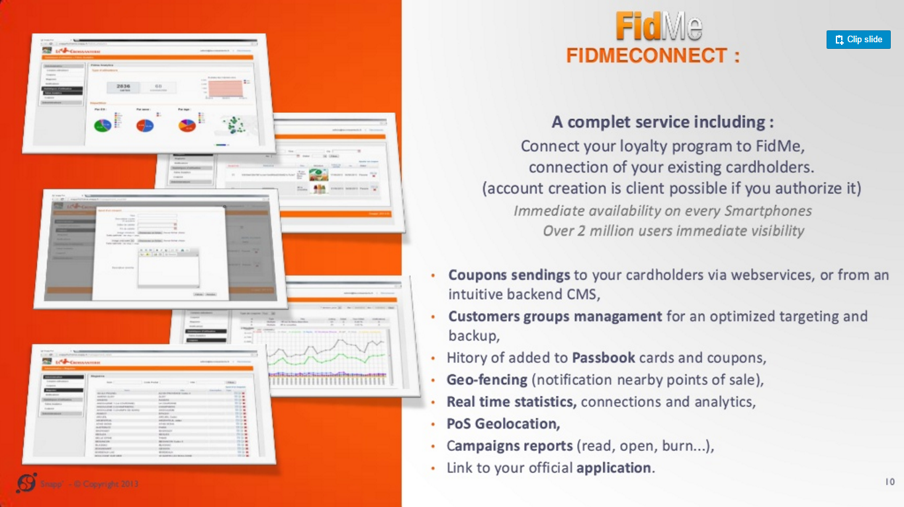

Slide 14
Solution Overview

Slide 15
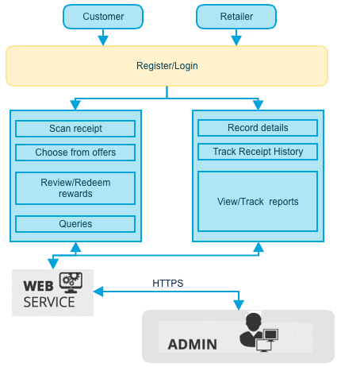
Solution Overview
Loyalty Point management application
Customer, Retailer & Admin as user base
Application Site admin to be hosted in web
API based data communication
Pre-classified offers
Complete management capabilities
Supports English & Arabic Language
Universal App
Data communication is secured mode (SSL)

Slide 16
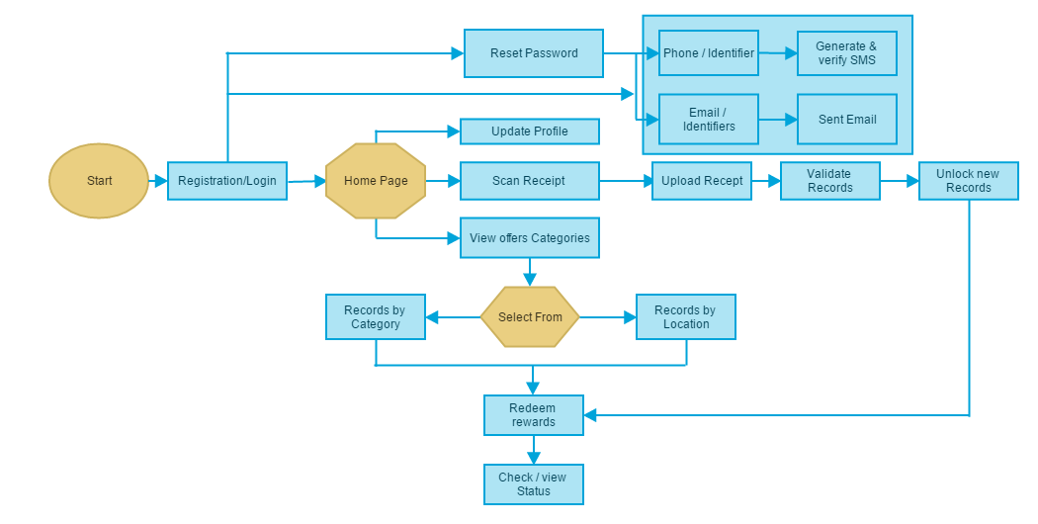
Application Work Flow - Customer

Slide 17
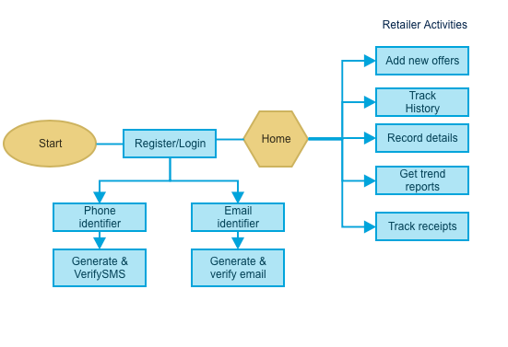
Application Work Flow - Retailer

Slide 18
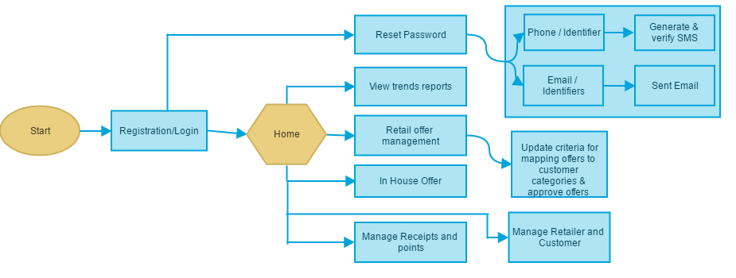
Application Work Flow – Admin (Web)

Slide 19
Application Functionality

Slide 20
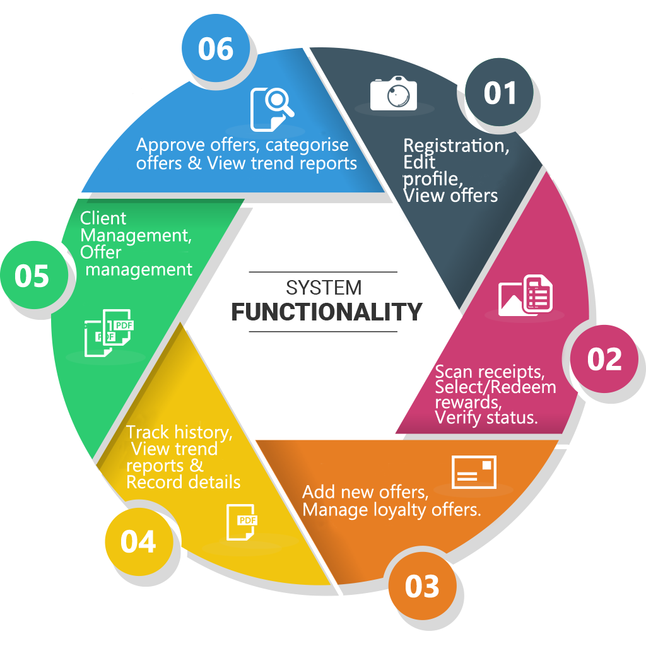
General Application Functionality
Loyalty Programme management
Registration based on user base
View/Redeem rewards - customer
Scan & upload receipt for verification
Offers, rewards management - Retailer
Approve offers - Admin

Slide 21
Feature Details
Retailer Features
Register as retailer
Manage offers (Add, Provide offer details, define value)
View Trend Report (Report emails, Redemption trends, Category details)
Track redemption history (Time specific reports, Track unredeemed/unexpired offers)
Admin Features
User Management
Retailer offer management (approve offers)
Update/Categorise offers
In-house offers
View trend reports (Retail redemptions, Spend trends, customer tier redemptions)
Manage customer loyalty points
Customer mobile front
Register/Update customer information
View status based offers
Upload scanned receipts
Select & redeem rewards (By category, location, preferred)
View reward status (past, current)
Ask questions/Send complaints
Additional Features
Camera to scan receipts
API’s to manage offers/events
Email/SMS based password activation/reset

Slide 22
Discovery Phase

Slide 23
Requirements Gathering
On signing the contract, Verbat will deploy a senior Business Analyst to discuss the business and technical requirements, define the solution approach, deliverables during each phases of execution, documentation and sign-off Deliverables
High level technical design
Detailed requirement specification document
Wireframes for the key screens for the proposed mobile application
HTML Prototype for proposed web application (Site Admin)
Dependencies
The client to nominate a Point of contact to coordinate with our team
Availability of key stakeholders for meetings to discuss requirements and validate findings and deliverables
Written sign-off on the deliverables prior to commencement of the development phase

Slide 24
Application Delivery

Slide 25
Application Delivery
Application will be delivered in three phases. Development will start post approval and sign-off of the Design Theme & Software Requirements Specification (SRS) by the client. The deliverables for each phase is listed below.
Phase 1 Delivery
Project plan
SRS & High level design
Theme selection (approve prototype)
Wire frames for key screens

Slide 26
Application Delivery (Contd.)
Phase 2 Delivery
Theme Integration for web app
UI/UX design for Mobile app
Password activation/reset based on email/sms option integration
Create Customer, Retailer mobile application work flow
Create admin web interface
Create Web API’s
Scanned receipt/ Selected reward based reward redemption
History and feedback components
Phase 3 Delivery
Quality Analysis
User Acceptance Testing (UAT)
Final product delivery
Upload to App Store
Hosting Web App to the online server

Slide 27
Technology Specification

Slide 28
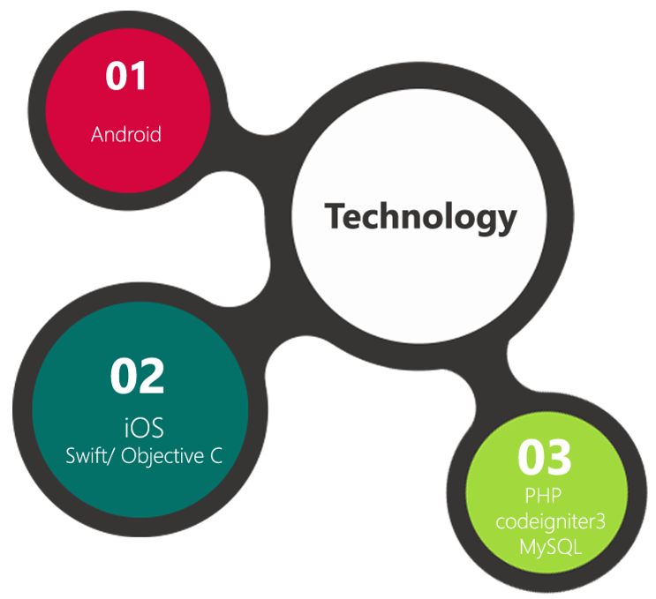
Technology Specifications
Technology Stack
Mobile App Development
Language: Java (Android), Swift/ObjectiveC (iOS)
API – JSON/XML
IDE – Android Studio, Xcode
Web Application
PHP
MySQL
Linux VPS Hosting
2 Cores, 4 GB RAM, 2 TB Bandwidth
165 GB Disk Space, 2 Ips

Slide 29
Project Timeline & Deliverables

Slide 30
Project Time line & Deliverables
The time estimated for delivering the application is 100 working man days
Activity | Phase | Effort (Man Days)
Initiation | Phase 1 | 14
Requirement Gathering Complete and Sign-Off
Software requirement Specification & functional Specification
UI Design
Database Design
Development Start | Phase 2 | 65.5
Theme Integration
UI/UX for Mobile Apps
User Management
Web Admin and Creating API’s
Manage Rewards, Receipts and Redeem
Reports
QA & Deployment | Phase 3 | 20.5
QA
UAT
Deployment & Go Live
Deliverables
Software Requirement Specification (SRS)
High level technical design
Wireframes for the key screens
UI/UX Theme
Functional Specification Document (FS)
Test plans & Test cases
User Manual (English)
Fully developed and tested application for deployment

Slide 31
Commercials

Slide 32
Commercials
Sl. | Description | Cost
01. | Development of UI/UX | AED
02. | Development of Loyalty Point Management Application & Testing | AED
03. | Hosting of the Application in Linux VPS Server (Yearly) | AED 17,000
04. | Positive WildCard SSL (Yearly) | AED 580

Slide 33
Commercials
Packaged Cost (Creative + Development)
Sl. | Description | Cost
01. | Development of Loyalty Point Management Application & Creative | AED
Packaged Cost (Including All)
Sl. | Description | Cost
01. | Development of Loyalty Point Management Application | AED

Slide 34
Assumptions & Out of Scope

Slide 35
Assumptions
Client need to provide branding guidelines
Client will specify offer categories
Client will provide the necessary details of verifying uploaded scanned receipt
Client will provide the formula for calculating reward points
Client need to purchase Apple and Google Developer accounts
Scanned receipts verification is done manually by the site admin
Orientation of Mobile app will be Portrait mode
The Web admin Interface will be in English
The Reports will be .csv format

Slide 36
Out of Scope
Automatic Receipt verification
Any language other than English & Arabic
Database migration
Backup solution and Disaster recovery for hosting
Annual Maintenance Contract
Theme customization
Purchase of SMS Gateway
Purchase of Domain Name

Slide 37
Terms & Conditions

Slide 38
Terms & Conditions
Offer Valid for 30 calendar days from the date of submission of the Proposal
An average of 20 working days are assumed in a month
This proposal and all technical/ functional specifications have been derived or concluded from the data shared via email / information's transferred during the initial requirement analysis meetings and conversations. Verbat reserves the right to amend the terms of this proposal, should the SOW terms, functional features and functionalities change during the course of the project
The applications will be built as per the specifications agreed mutually. Any changes will be executed through a deﬁned change management process between both parties
All Source Code and other project artefacts would adhere to the Verbat document templates and internal coding standards
Verbat will provide a bug ﬁx warranty at no additional cost for 30 days from the date of acceptance of the project, for correction of any errors in the developed application that may be attributed to Verbat
Acceptance criteria will be based on the clauses which were mutually discussed between Verbat and client at the Requirement Analysis phase and the same will be documented and approved by both parties through official emails
Final deployment to production server pursuant to completion of all payments

Slide 39



Contact Us
217, Sheikh Rashid Bldg
P.O Box 56272, Dubai United Arab Emirates
+971 04 2973236
Lekshmi.krishna@verbat.com
India
Verbat Technologies (India) Pvt. Ltd. Level 3, PTC Tower Trivandrum, Kerala
USA 2033 Gateway Place
Suite 500
San Jose , CA- 95110

Slide 40

Thank You
© 2016. All Rights Reserved Verbanet Technologies LLC www.verbat.com

